Slide 1
Design and Analysis

Slide 2
MS Logical
Architecture
Api Gateway
Event Service
Web App
DB
Message broker
Mobile app
Employee Service
DB
IOT App
Notification Service
DB

Slide 3


MS Physical
Architecture
Api Gateway
Event Service
Event Service
Web App
DB
Kafka Server
Mobile app
Employee Service
Employee Service
DB
IOT App
Notification Service
Notification Service
DB
Eureka Service Registry
Zipkin Distributed Tracing
Registers

Slide 4
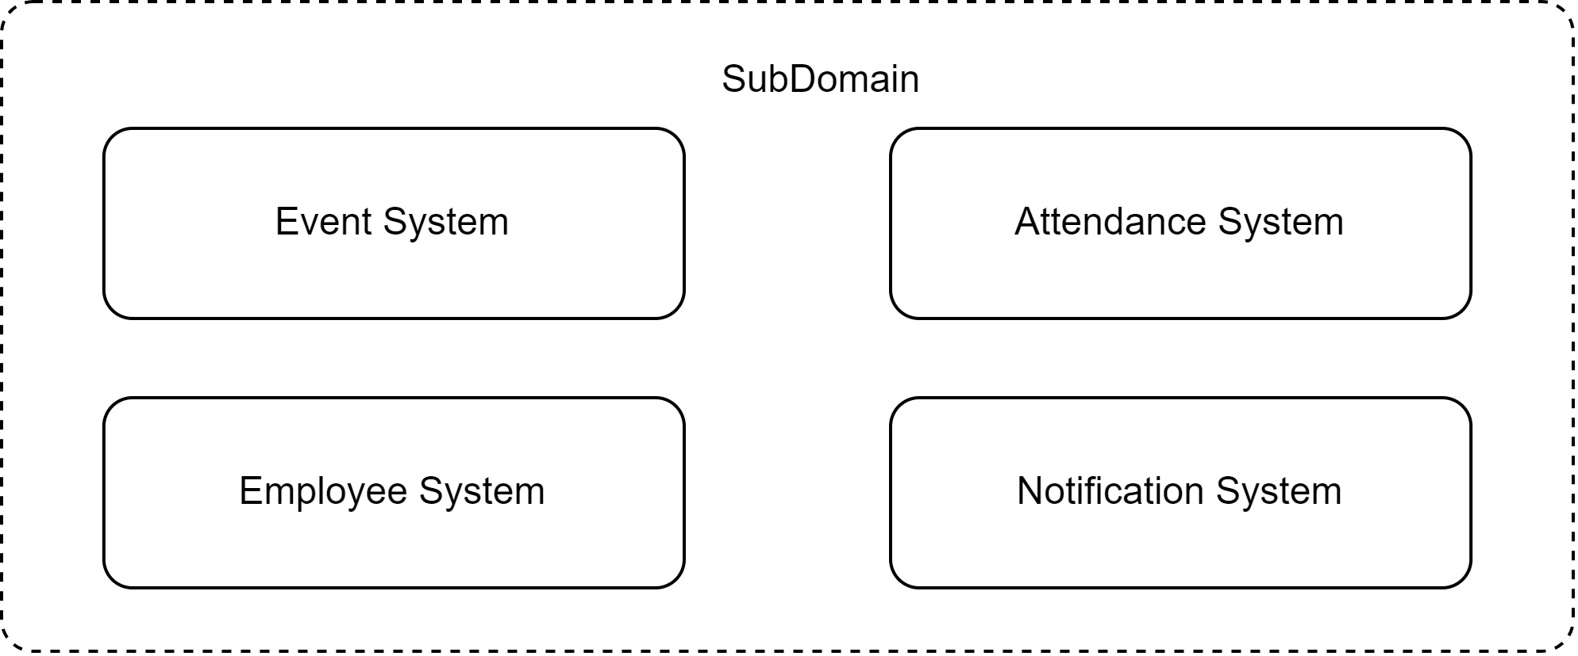
Domain

Slide 5
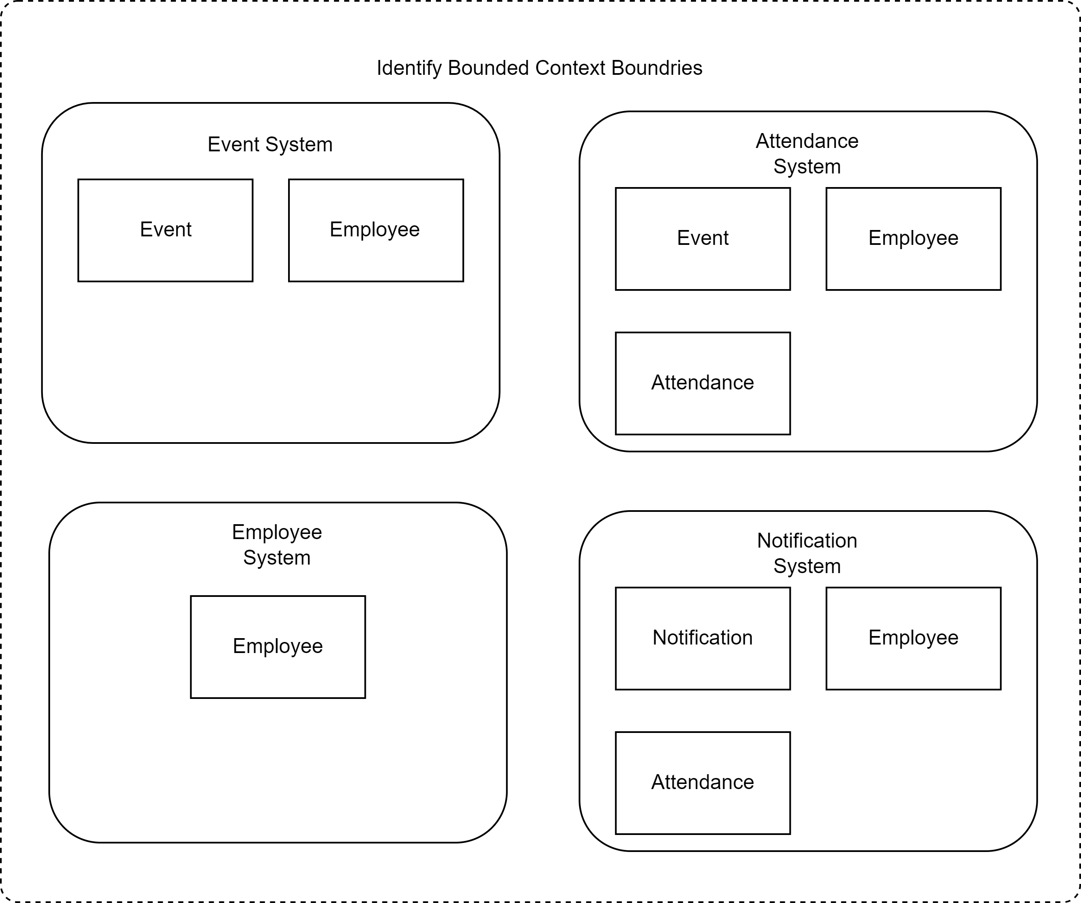
Subdomain Bounded
Context

Slide 6
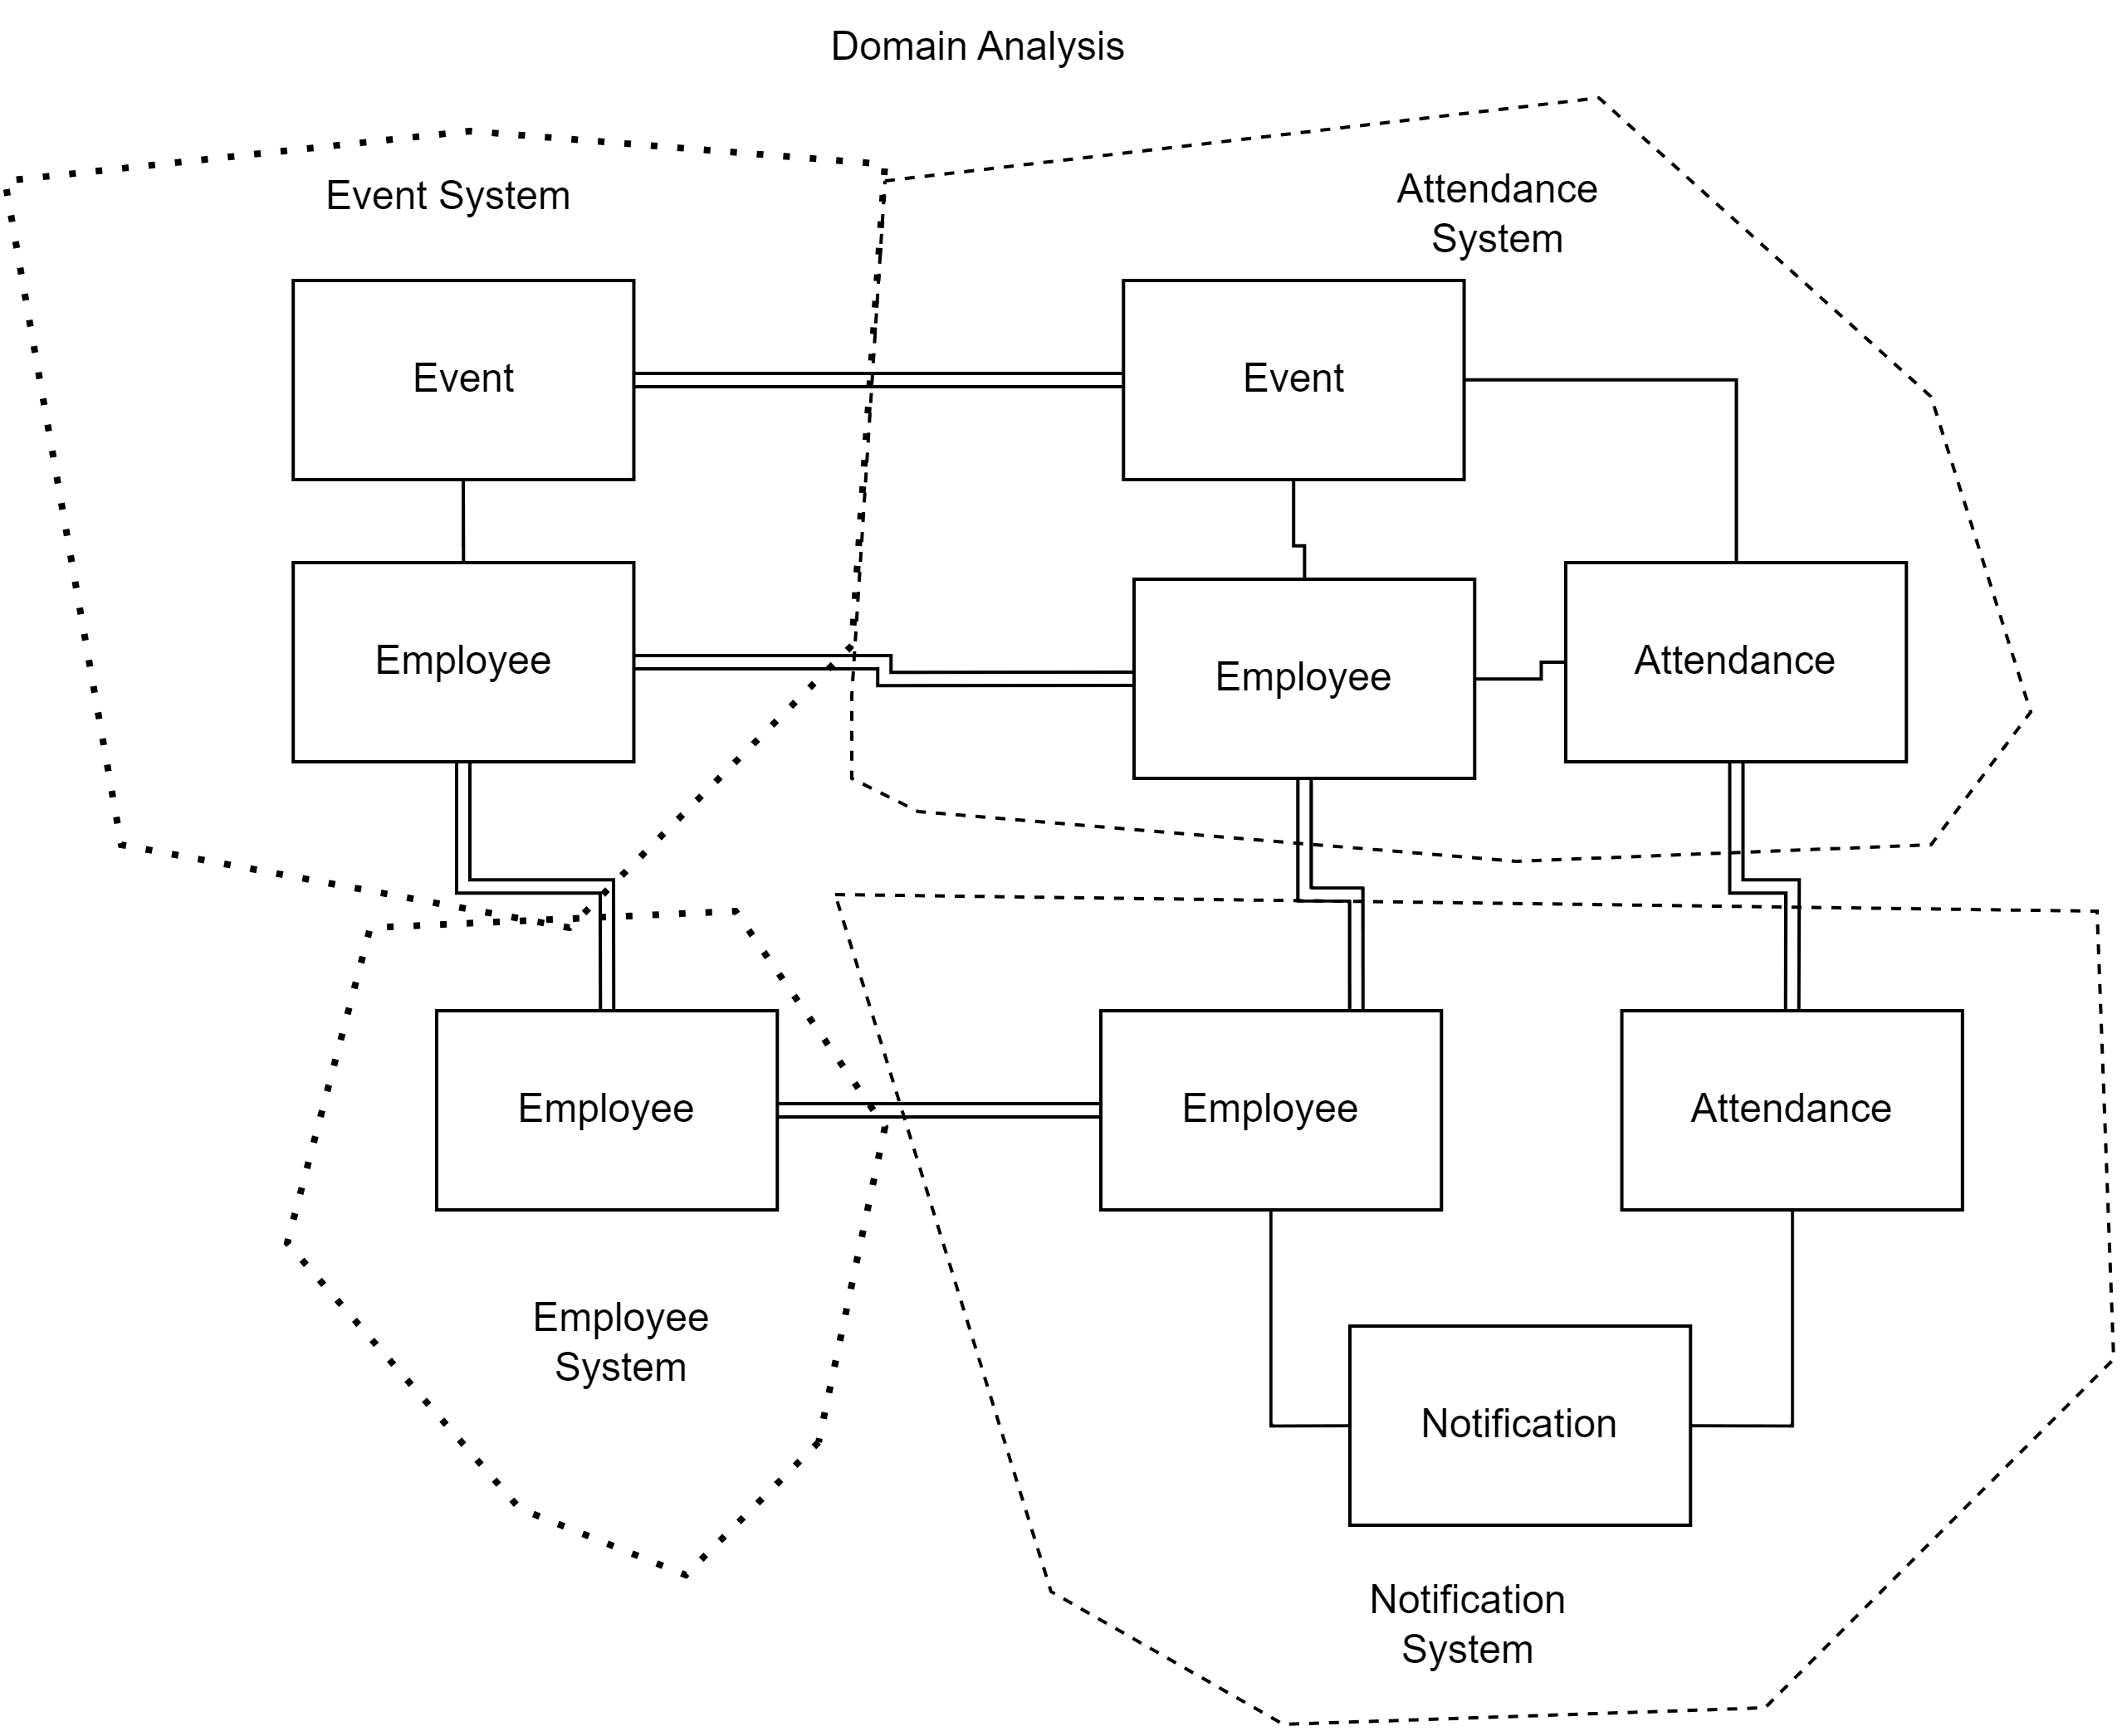
Business context diagram

Slide 7
EDA
Event Service
Notification Service
DB
DB
Produce Events
Consume Notification
Event Bus
Consume Events
Produce Notification
Employee Service
DB

